Slide 1
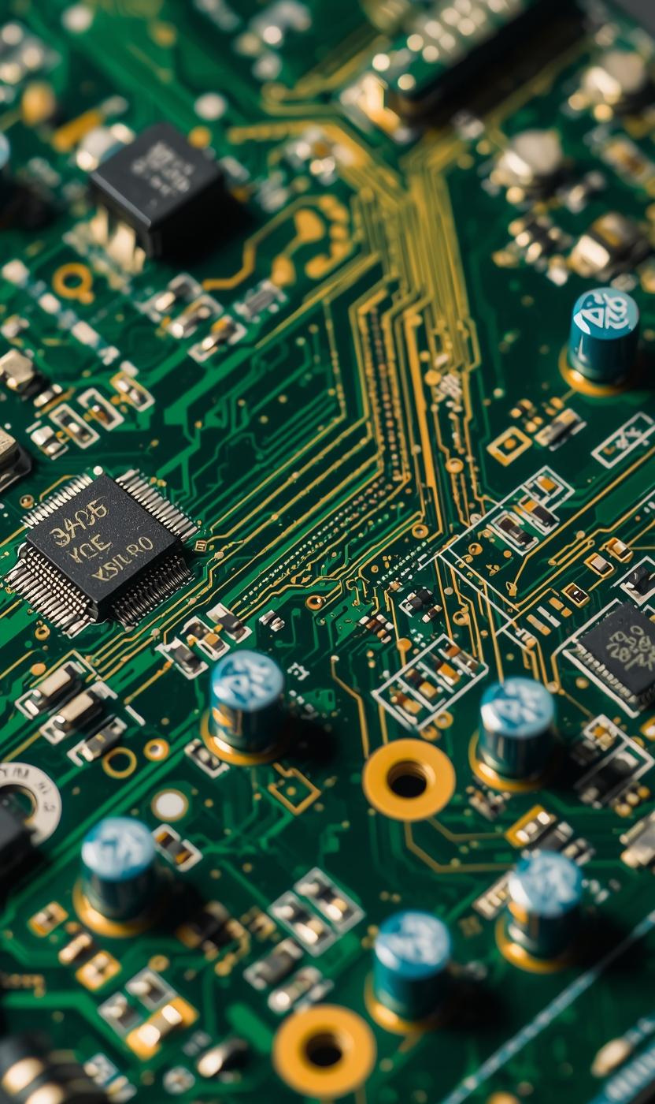

PCB Defect Detection
PRESENTED BY [VISHWA ADHESH SK]

Slide 2
Understanding PCB Defect Detection Challenges
INEFFICIENCIES AND ERRORS
Manual inspection processes often lead to significant inefficiencies and errors, affecting the overall quality of PCB manufacturing.
THE ROLE OF AUTOMATION
Automating defect detection minimizes human error, enhances speed and accuracy, and ultimately drives down production costs significantly.

Slide 3
Motivation for Automation Using AI
LIMITATIONS OF TRADITIONAL INSPECTION
Traditional inspection methods suffer from human fatigue and inconsistency, leading to errors that compromise PCB quality and overall production efficiency.
BENEFITS OF AI ADOPTION
AI-driven automation offers scalability and improved defect recognition, resulting in more reliable inspections and significant cost savings for manufacturers.

Slide 4
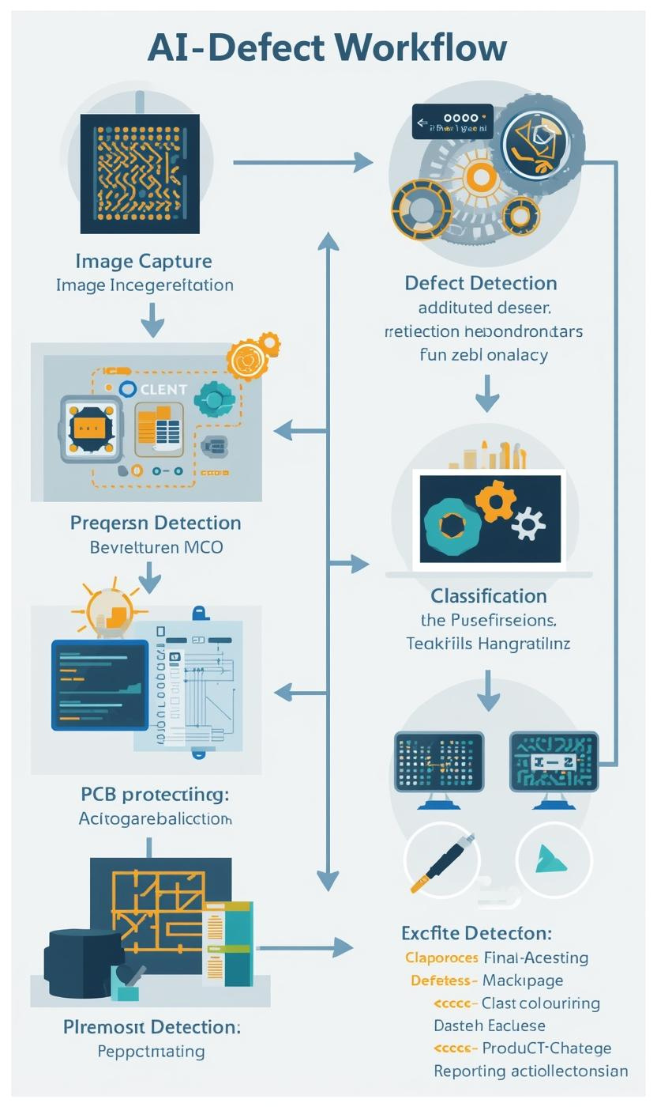
Overview of AI-Powered Defect Detection System
FROM IMAGE CAPTURE TO OUTPUT
This system integrates image capture, processing, defect detection, classification, and reporting to enhance PCB quality control using advanced AI techniques.

Slide 5

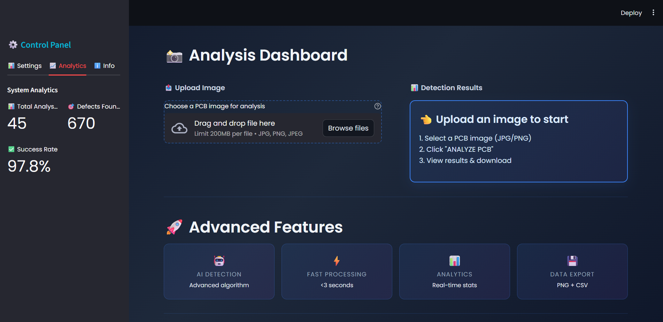
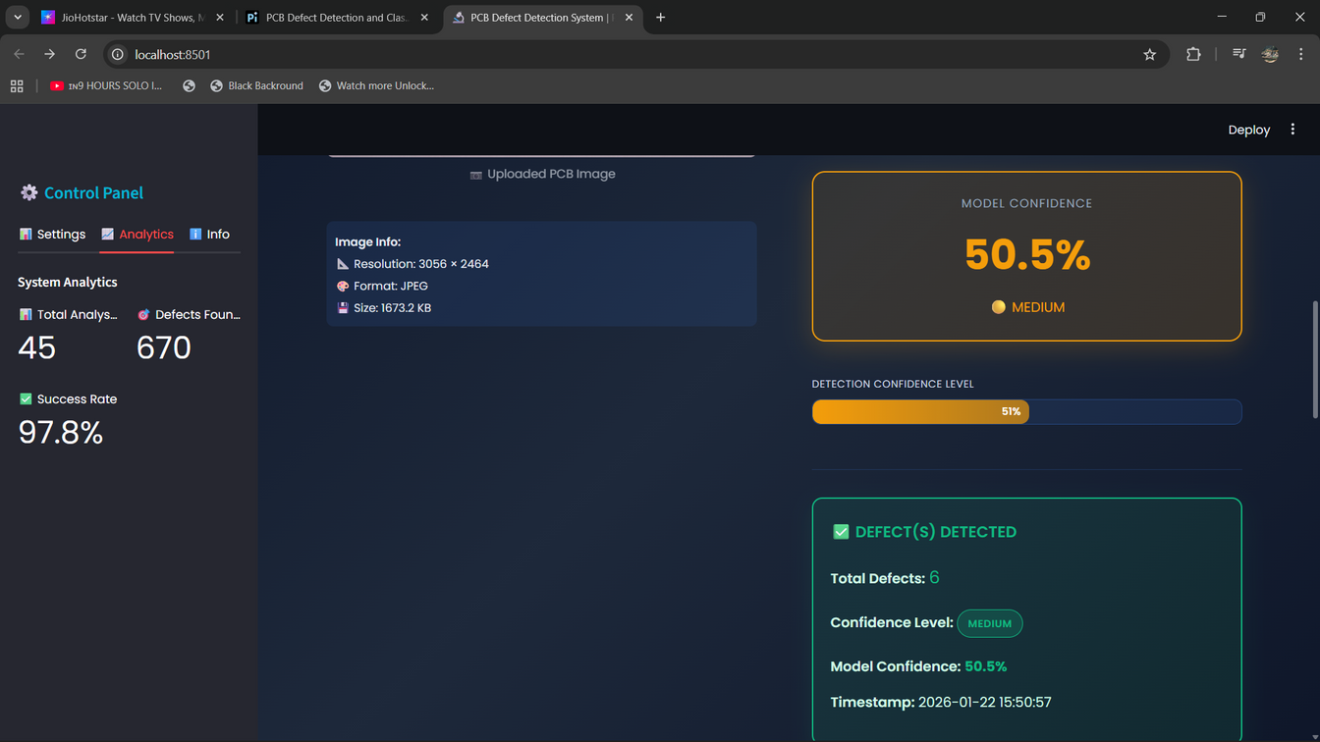
Model Evaluation Metrics
PRECISION
Precision indicates the percentage of true positive results among all positive identifications, reflecting the model's reliability in defect classification.
ACCURACY
Accuracy measures the proportion of correctly identified defects, providing an overall assessment of the model's performance in defect detection.
RECALL
Recall assesses the model's ability to identify all actual defects, highlighting its effectiveness in minimizing false negatives during inspections.

Slide 6
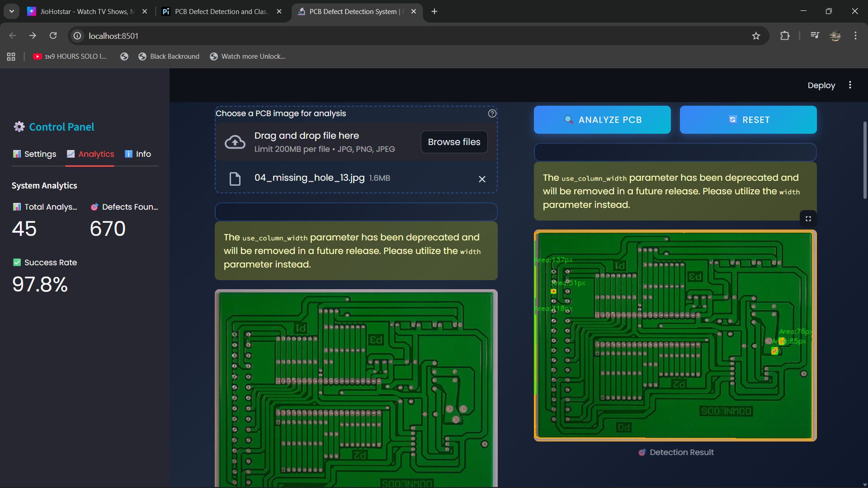
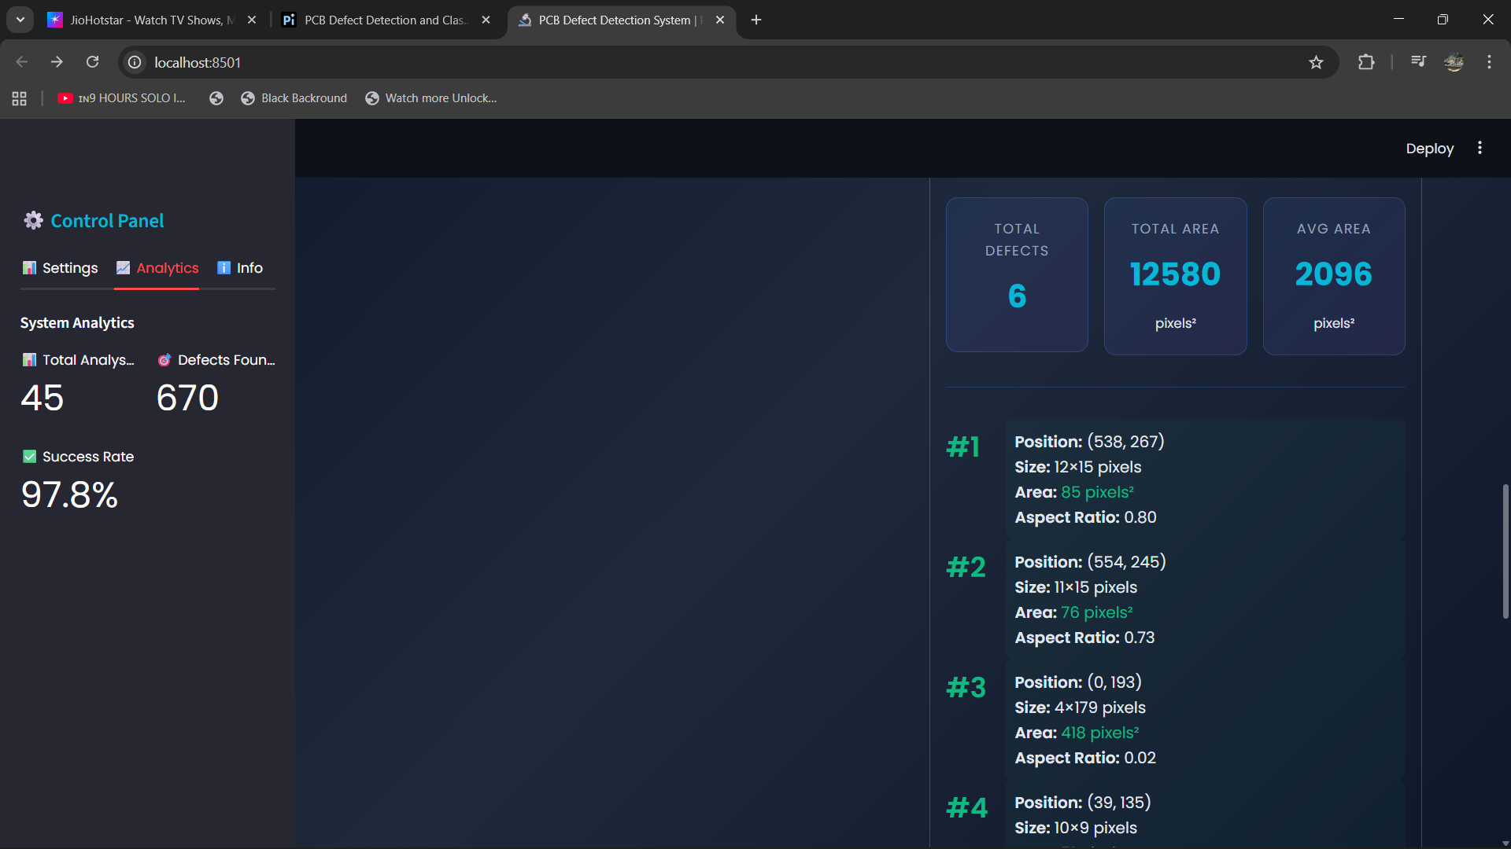
Enhancing User Interaction with the System
STREAMLINED DASHBOARD FEATURES
The user interface allows easy image uploads, providing real-time feedback on processing status and visualizing detected defects for efficient inspection.

Slide 7
Enhanced User Experience
DASHBOARD FEATURES
The dashboard includes intuitive controls for image uploads, processing status updates, and easy navigation for defect visualization, ensuring user-friendly interaction.
REAL-TIME FEEDBACK
Users receive immediate feedback during processing, allowing adjustments to be made on-the-fly, which enhances efficiency and improves overall inspection outcomes.

Slide 8
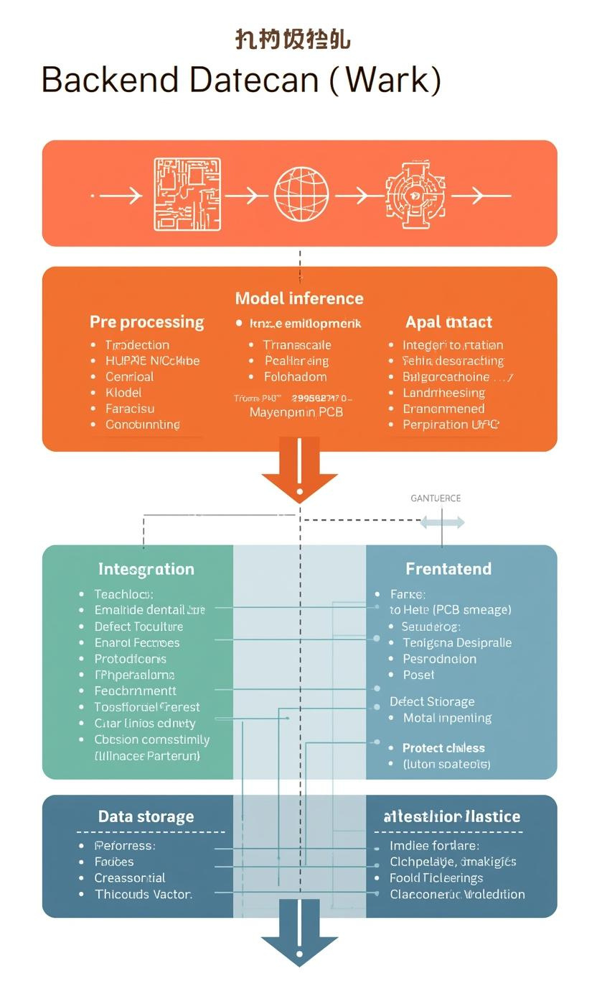
Backend Workflow and System Integration
IMAGE PROCESSING PIPELINE
The backend integrates various components, handling image processing, model inference, and data storage, ensuring seamless communication between the frontend and backend systems.

Slide 9
Seamless Integration and Scalability
FRONTEND COLLABORATION
The AI detection system integrates with the frontend interface, allowing for efficient data flow and smooth user interactions during inspections.
SYSTEM ARCHITECTURE
A robust architecture supports scalability, ensuring the system can handle increased workloads and adapt to future technological advancements in PCB inspection.

Slide 10
Output Results and Export
REVIEW PROCESS
Detected defect images can be reviewed directly from the dashboard, allowing quality assurance personnel to analyze issues effectively and efficiently.
DOWNLOAD FEATURES
Users can easily download defect images and reports through intuitive dashboard features, ensuring seamless access to vital documentation for auditing purposes.
TRACEABILITY BENEFITS
The system enhances traceability by documenting defect occurrences, which supports quality control processes and compliance with industry standards for manufacturing.

Slide 11
Benefits of AI-Based PCB Inspection
ENHANCED ACCURACY
Implementing AI in PCB inspection significantly improves accuracy, reducing human error and ensuring that defects are detected consistently.
COST EFFICIENCY
Automation leads to faster inspections, lowering operational costs while boosting productivity and overall manufacturing quality in the PCB industry.

Slide 12


Conclusion and Future Directions
EMAIL ADDRESS
vishwavsb65@gmail.com
PHONE
9042929345

